Slide 1
SPRINT 4
REPORT
Zachary Mullin, Luis Zarate, Jesse Boakye
Client: Ron Wright
Mentor: Parteek Kumar
2026
Team ZJL

Slide 2
Project Introduction
Our project is an AI Tutoring system that allows the student to guide their own learning and curriculum, while also giving teachers and administrators control to monitor student behavior and intervene if a student is shown to be struggling.

Slide 3

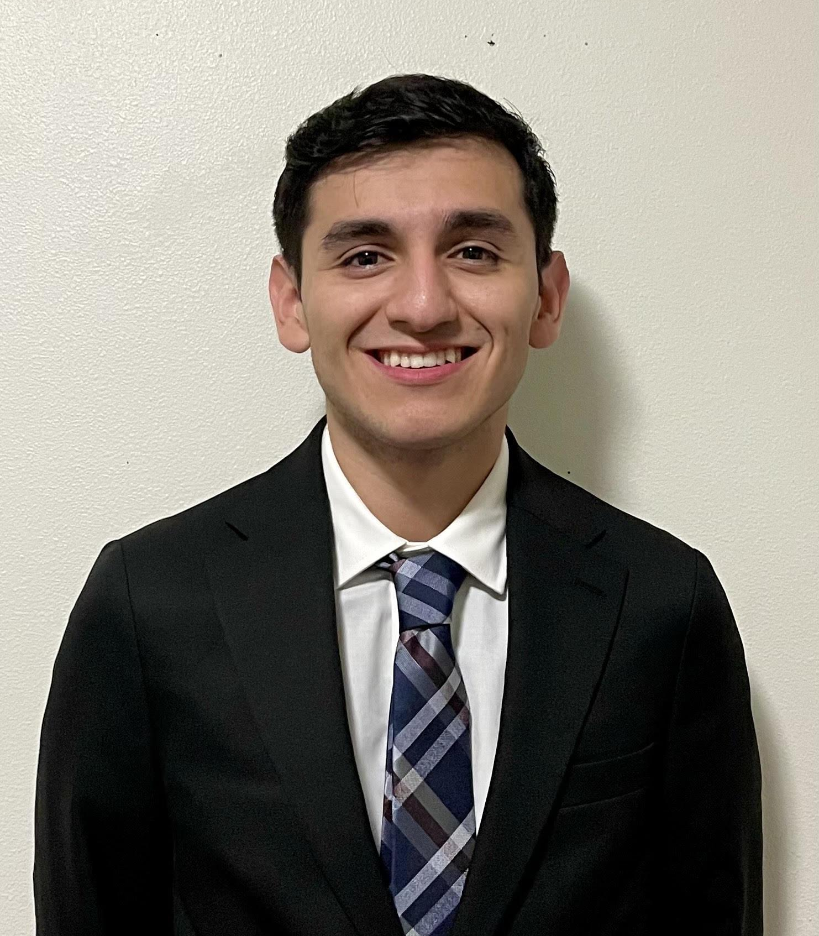

Team Roles
Zachary Mullin
Luis Zarate
Jesse Boakye
Backend, Teacher Chat History, Teacher Progress Tracker View, Intervention Alerts
Backend, Quiz System Refactor, Debugging, Documentation
Front-end, Polishing, Quiz-system Design, Read-only quizzes for chat histories

Slide 4
Sprint 4 Objectives
Progress Tracker
Teacher Intervention Alerts and Monitoring
This was the major focus of Sprint 4.
The systems were there at the end of Sprint 3, but they did not connect to the rest of the software
This sprint was focused on connecting the quiz system with the progress tracker to show actual progress being made over time.
Refined Quiz System
The “Intervention” tab of the Teacher Dashboard is now available
A student will appear in the Intervention tab if they have below a 70% quiz average in the progress tracker
The Intervention tab will have a ⚠️ icon next to it if a student has below a 50% quiz average
Teachers can view chat history and progress dashboards of students in their class
Frontend Polishing
The quiz system was changed to better reflect our goals with the Progress Tracker.
The LLM no longer grades the quiz, it is done via the actual code.
Short-answer questions have been unfortunately removed due to this change, but it allows the quiz system to be less reliant on the LLM and more deterministic, which helped us design the progress tracker
Teachers can view a simplified version of the chat screen when viewing chat history
Progress tracker page data is now shown in a more useful way (percentages instead of decimals)
Previous quizzes will appear in session history as read-only UI elements instead of raw JSON
Notes:
Jesse

Slide 5
Features Demo

Slide 6
Kanban Board Overview

Slide 7
Documentation of Report

Slide 8
Responsible Use of AI
Google Gemini API was used in the testing phase in place of a local LLM due to an inability to run a local LLM on our home machines. The model used was Gemini 2.5 Flash Lite.
Other generative AI tools like ChatGPT were used exclusively for debugging purposes. The code was written and reviewed by us.

Slide 9
Sprint 4 Achievements
Sprint 4 Challenges
Progress Tracker is finally complete
This was the most annoying and most complex task
Couldn’t work on it until all other systems were functional
With it complete, the project is basically 90-95% done
The application is at a semi-polished state
Some edge cases still have to be worked out and some UI polishing needs to be done, but everything works as expected and is useable by students and teachers.
Last big leap: stress testing the system on a server with a local LLM and multiple users at once
Using a local LLM proved to be the most difficult hurdle
Does not run on our home machines
Could not get access to a school server
Used the paid Gemini API in the meantime
Swapping between models has proven to be more work than expected
Mistral, Qwen, DeepSeek, LLaMA, etc. all use different formats and libraries
Swapping to any model on Huggingface on the fly is not feasible
It’s not an elegant solution, but the best solution would be to have 3-4 model ‘brands’ and create modules for each one, and you can select any model from those ‘brands’ to use

Slide 10
Next Steps
Sprint 5
Sprint 6
Full feature completion
Deployment on Server
Final Delivery and Documentation
Beginning extensive testing
Final remaining features will be completed, including bulk student account importing and student data exporting
Working with a local LLM (likely Mistral) to achieve similar performance to Gemini
Additional security tests and implementation
Final polishing needed before deployment
Create training documentation and videos for teachers, administrators and students to understand how to use the system
Make the system easier to install
Formally present software to client
Will allow us to run a local LLM more efficiently
Allows for end-users (students) to test the system alongside us
Will work with the client to complete this task
Early March AT THE LATEST, likely late February

Slide 11
While there were setbacks, especially in regard to the local LLM and our plans for it, it is now our primary focus and the last thing we need to complete this project. Everything is in order to begin testing on a server as early as next week.
Sprint Retrospective

Slide 12
The project is on schedule
The current goal is to deploy the system on a server to test a local LLM
Testing begins now!
Conclusion

Slide 13
THANK YOU

